Slide 1
HOP-HMM
Classification of DNA Sequences
David Taub

Slide 2
Outlines
Research Goal
Gene Regulation
TFBS & PWMs
HMM
HOP-HMM
Baum-Welch
Evaluation
Human DNA

Slide 3
Classification of DNA Sequences
TTACAGAGATAACGAGCTACTTTATTAAGACATTACGTTACAGAGATAAGACATCTTTATGACATACATTACGTTACATAAGACATCTGTGTACGTTACTTTATTAATACGTTACGT
Enhancer
Promoter
Gene
DNA
TF
TF
Transcription Factor Binding Sites

Slide 4
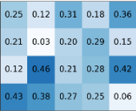
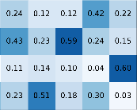
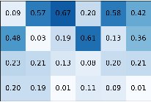








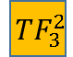

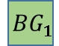
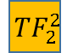

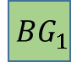

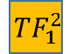









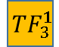



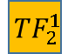
HMM to HOP-HMM
HOP-HMM
$$0.5$$
$$0.05$$
$$0.0$$
$$0.05$$
$$0.1$$
$$0.8$$
$$BG_{1}$$
$$TF_{1}^{1}$$
$$TF_{2}^{1}$$
$$TF_{3}^{1}$$
HMM
$$1$$
$$G$$
$$T$$
$$A$$
$$C$$
$$BG_{1}$$
$$BG_{2}$$
$$0.5$$
$$G$$
$$T$$
$$0.8$$
$$BG_{2}$$
$$TF_{1}^{2}$$
$$TF_{2}^{2}$$
$$TF_{3}^{2}$$
$$G$$
$$T$$
$$A$$
$$C$$
$$A$$
$$C$$
$$0.1$$
$$1$$
$$G$$
$$T$$
$$A$$
$$C$$

Slide 5
Outlines
Research Goal
Gene Regulation
TFBS & PWMs
HMM
HOP-HMM
Baum-Welch
Evaluation
Human DNA

Slide 6
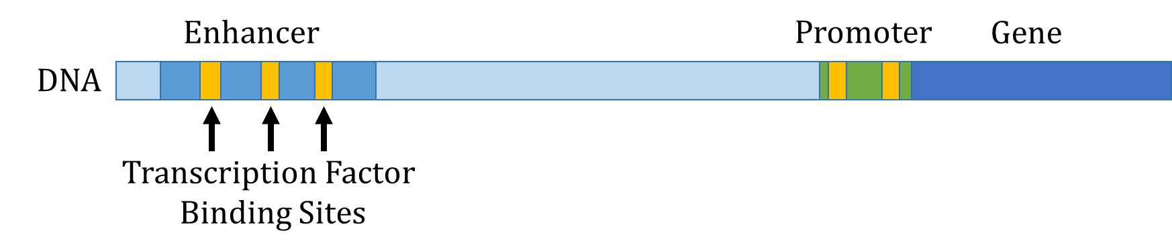

Slide 7
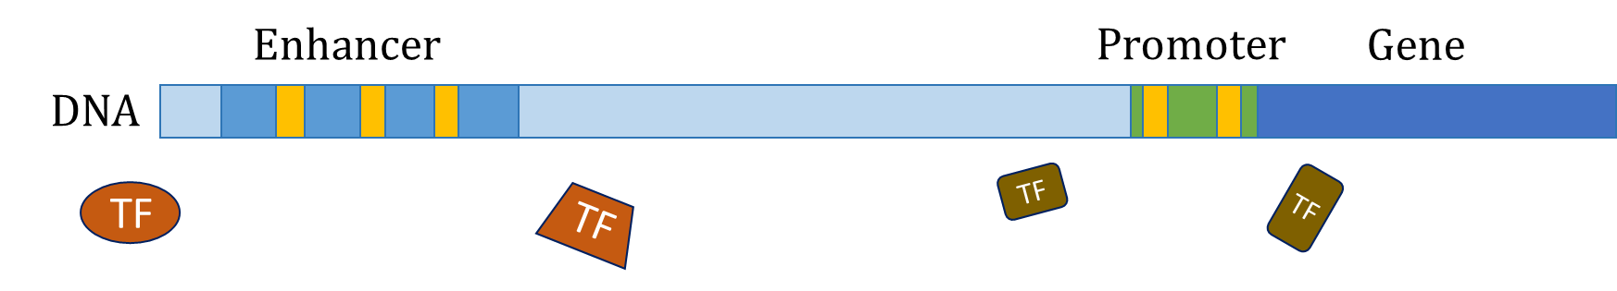

Slide 8
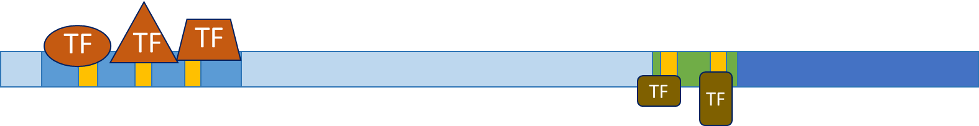

Slide 9


Slide 10
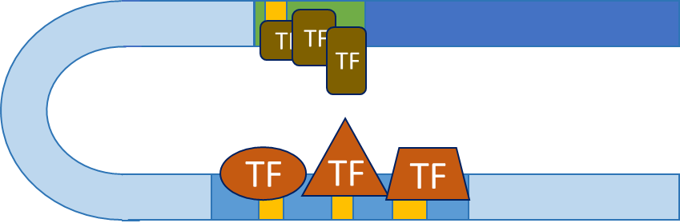

Slide 11
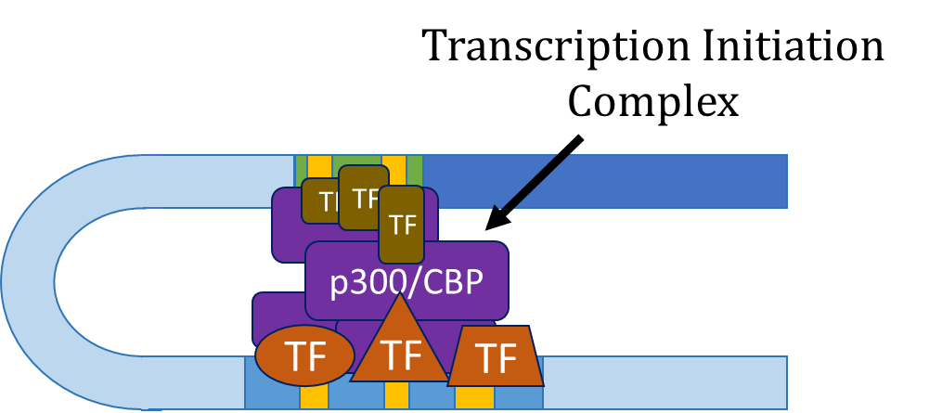

Slide 12
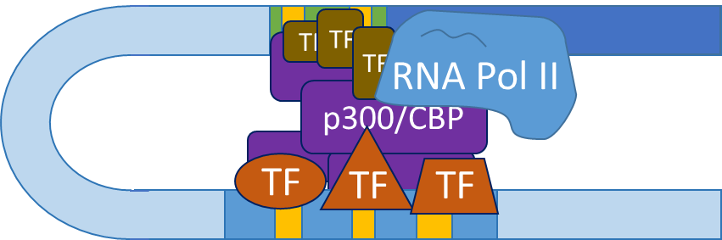

Slide 13
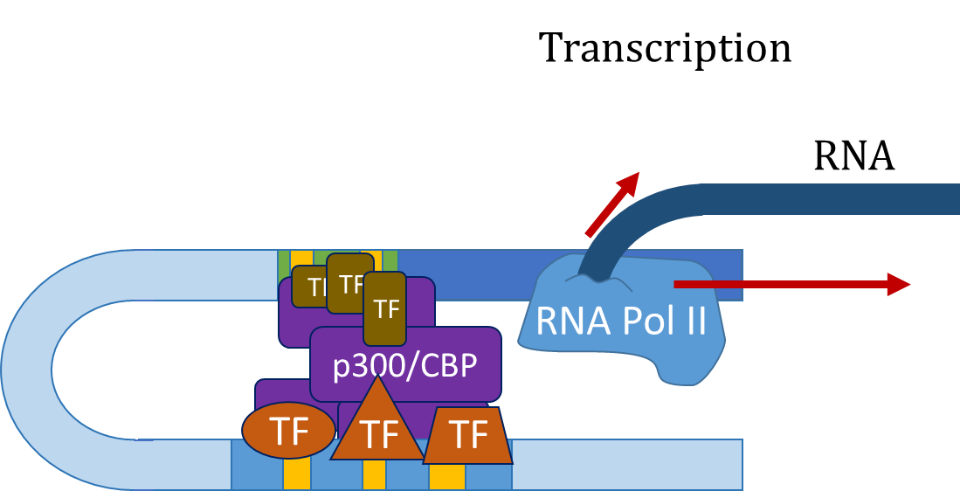

Slide 14
Outlines
Research Goal
Gene Regulation
TFBS & PWMs
HMM
HOP-HMM
Baum-Welch
Evaluation
Human DNA

Slide 15
TFBS & PWMs
Enhancer
DNA
TF
TF
Transcription Factor Binding Sites

Slide 16
TFBS & PWMs
…CGAGCTACTTTATTAAGACATTACGTTACAGAGATAA…
Enhancer
DNA
TF
TF
Transcription Factor Binding Sites

Slide 17

TFBS & PWMs
…CGAGCTACTTTATTAAGACATTACGTTACAGAGATAA…
$$P\left(x=\text{GCTACTTT} | binding\right)= ?$$

Slide 18
TFBS & PWMs
…CGAGCTACTTTATTAAGACATTACGTTACAGAGATAA…
$$P\left(x=\text{GCTACTTT} | binding\right)= ?$$
other binding sites
(ChIP-seq)
ACTACTTT
CCGACTTT
GTAACTCA
GGGAGGCT
GTGGCGCT
GGAACGTG
GCTACTTT

Slide 19
TFBS & PWMs
…CGAGCTACTTTATTAAGACATTACGTTACAGAGATAA…
$$P\left(x=\text{GCTACTTT} | binding\right)= ?$$
other binding sites
(ChIP-seq)
A:10260001
C:13306030
G:52011301
T:02200445
ACTACTTT
CCGACTTT
GTAACTCA
GGGAGGCT
GTGGCGCT
GGAACGTG
GCTACTTT

Slide 20
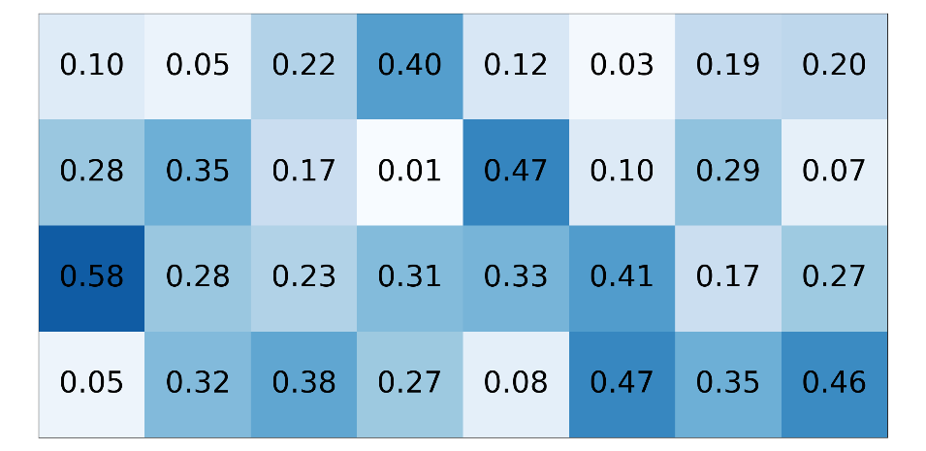
TFBS & PWMs
…CGAGCTACTTTATTAAGACATTACGTTACAGAGATAA…
$$P\left(x=\text{GCTACTTT} | binding\right)= ?$$
other binding sites
(ChIP-seq)
PWM (W)
A:10260001
C:13306030
G:52011301
T:02200445
ACTACTTT
CCGACTTT
GTAACTCA
GGGAGGCT
GTGGCGCT
GGAACGTG
GCTACTTT

Slide 21
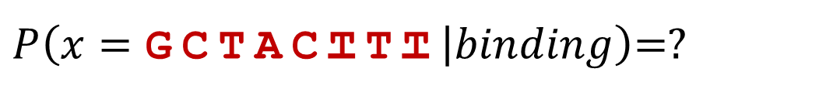
TFBS & PWMs
…CGAGCTACTTTATTAAGACATTACGTTACAGAGATAA…
$P\left(x=\text{GCTACTTT} | binding\right)$=?
PWM (W)

Slide 22
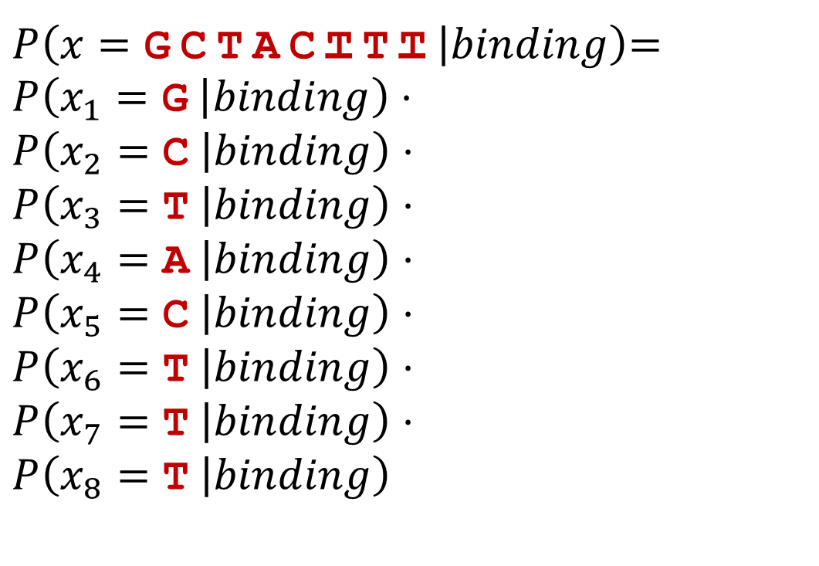
TFBS & PWMs
…CGAGCTACTTTATTAAGACATTACGTTACAGAGATAA…
$P\left(x=\text{GCTACTTT} | binding\right)$=
$$P\left(x_{1}=\text{G} | binding\right)⋅$$
$$P\left(x_{2}=\text{C} | binding\right)⋅$$
$$P\left(x_{3}=\text{T} | binding\right)⋅$$
$$P\left(x_{4}=\text{A} | binding\right)⋅$$
$$P\left(x_{5}=\text{C} | binding\right)⋅$$
$$P\left(x_{6}=\text{T} | binding\right)⋅$$
$$P\left(x_{7}=\text{T} | binding\right)⋅$$
$$P\left(x_{8}=\text{T} | binding\right)$$
positional independence assumption
PWM (W)

Slide 23
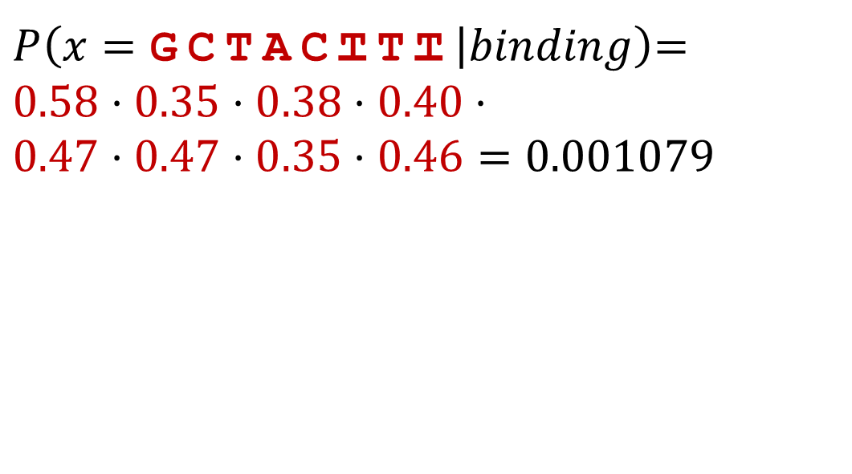
TFBS & PWMs
…CGAGCTACTTTATTAAGACATTACGTTACAGAGATAA…
$P\left(x=\text{GCTACTTT} | binding\right)$=
$$0.58⋅0.35⋅0.38⋅0.40⋅$$
$$0.47⋅0.47⋅0.35⋅0.46=\text{0}\text{.}\text{001079}$$
PWM (W)

Slide 24
TFBS & PWMs
…CGAGCTACTTTATTAAGACATTACGTTACAGAGATAA…
$P\left(x=\text{GCTACTTT} | binding\right)$=
$$0.58⋅0.35⋅0.38⋅0.40⋅$$
$$0.47⋅0.47⋅0.35⋅0.46=\text{0}\text{.}\text{001079}$$
PWM (W)
Small number,
log likelihood is more convenient

Slide 25
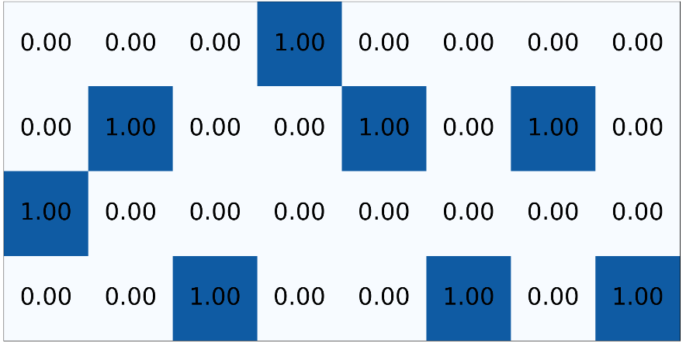

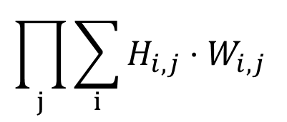
Using PWMs
…CGACTCCGTATA…
One-hot encoding (H)
PWM (W)
$$\prod_{j}{\sum_{i}{H_{i,j}}⋅W_{i,j}}$$
*

Slide 26
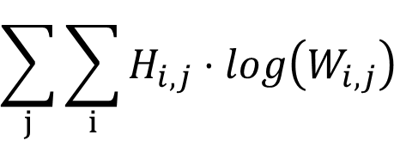
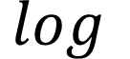
Using PWMs
…CGACTCCGTATA…
One-hot encoding (H)
PWM (W)
$$\sum_{j}{\sum_{i}{H_{i,j}}⋅log\left(W_{i,j}\right) }$$
*
$$log$$

Slide 27
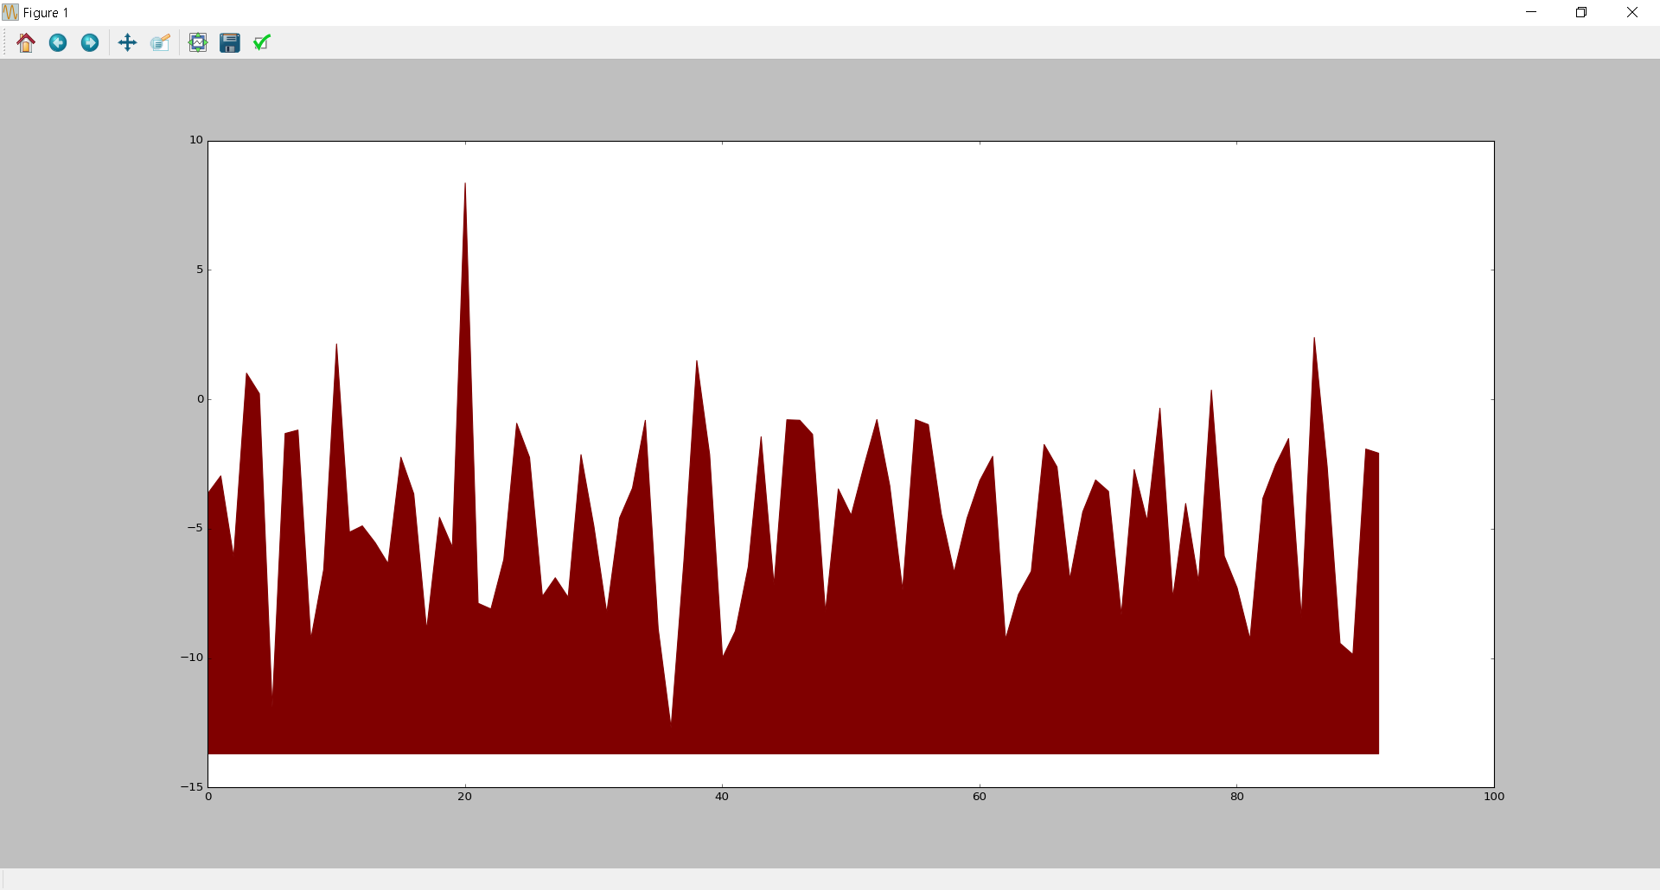
Using PWMs
…CGACTCCGTATA…
One-hot encoding (H)
PWM (W)
$$\sum_{j}{\sum_{i}{H_{i,j}}⋅log\left(W_{i,j}\right) }$$
*
$$log$$
Log likelihood of TF binding
Location in sequence

Slide 28
Outlines
Research Goal
Gene Regulation
TFBS & PWMs
HMM
HOP-HMM
Baum-Welch
Evaluation
Human DNA

Slide 29
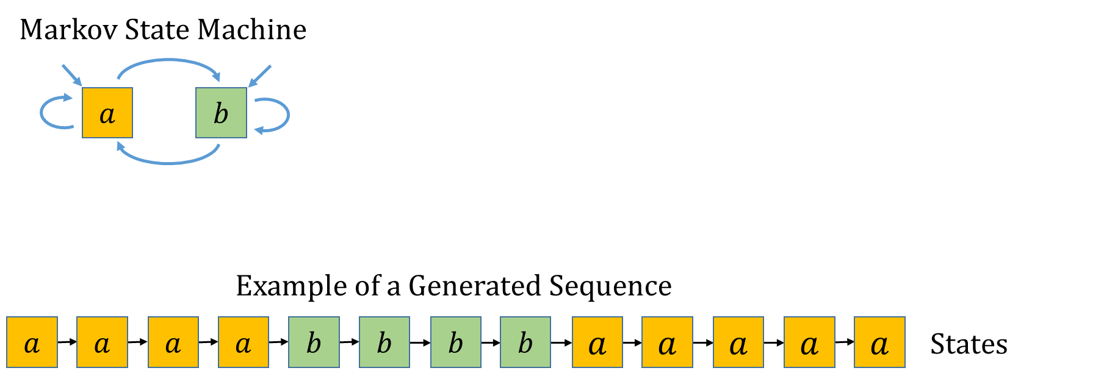
Hidden Markov Model

Slide 30
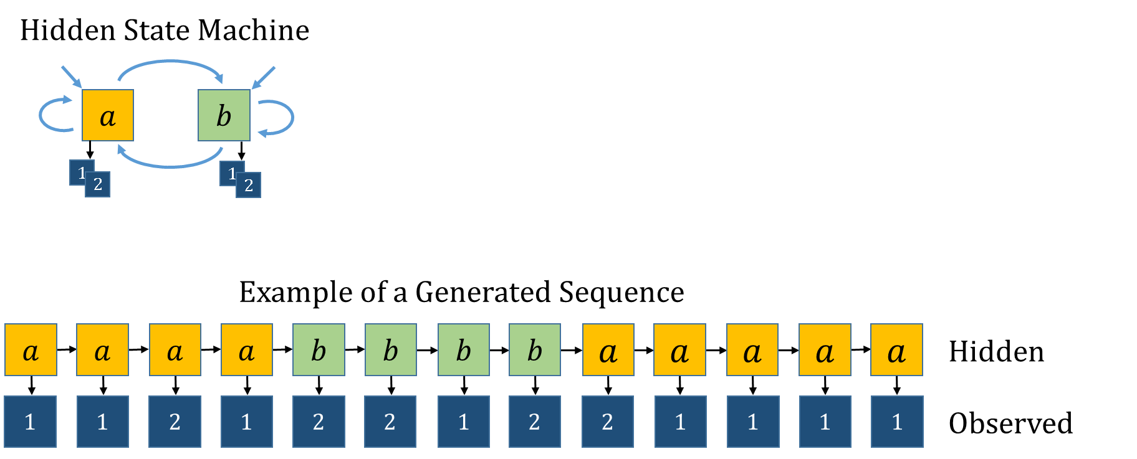
Hidden Markov Model

Slide 31
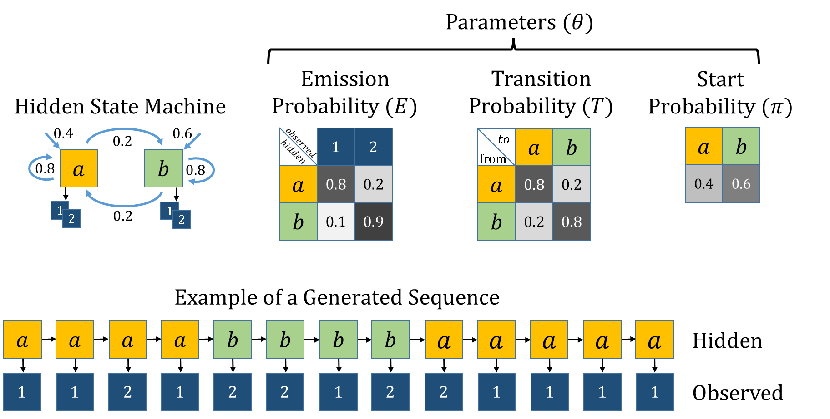
Hidden Markov Model

Slide 32
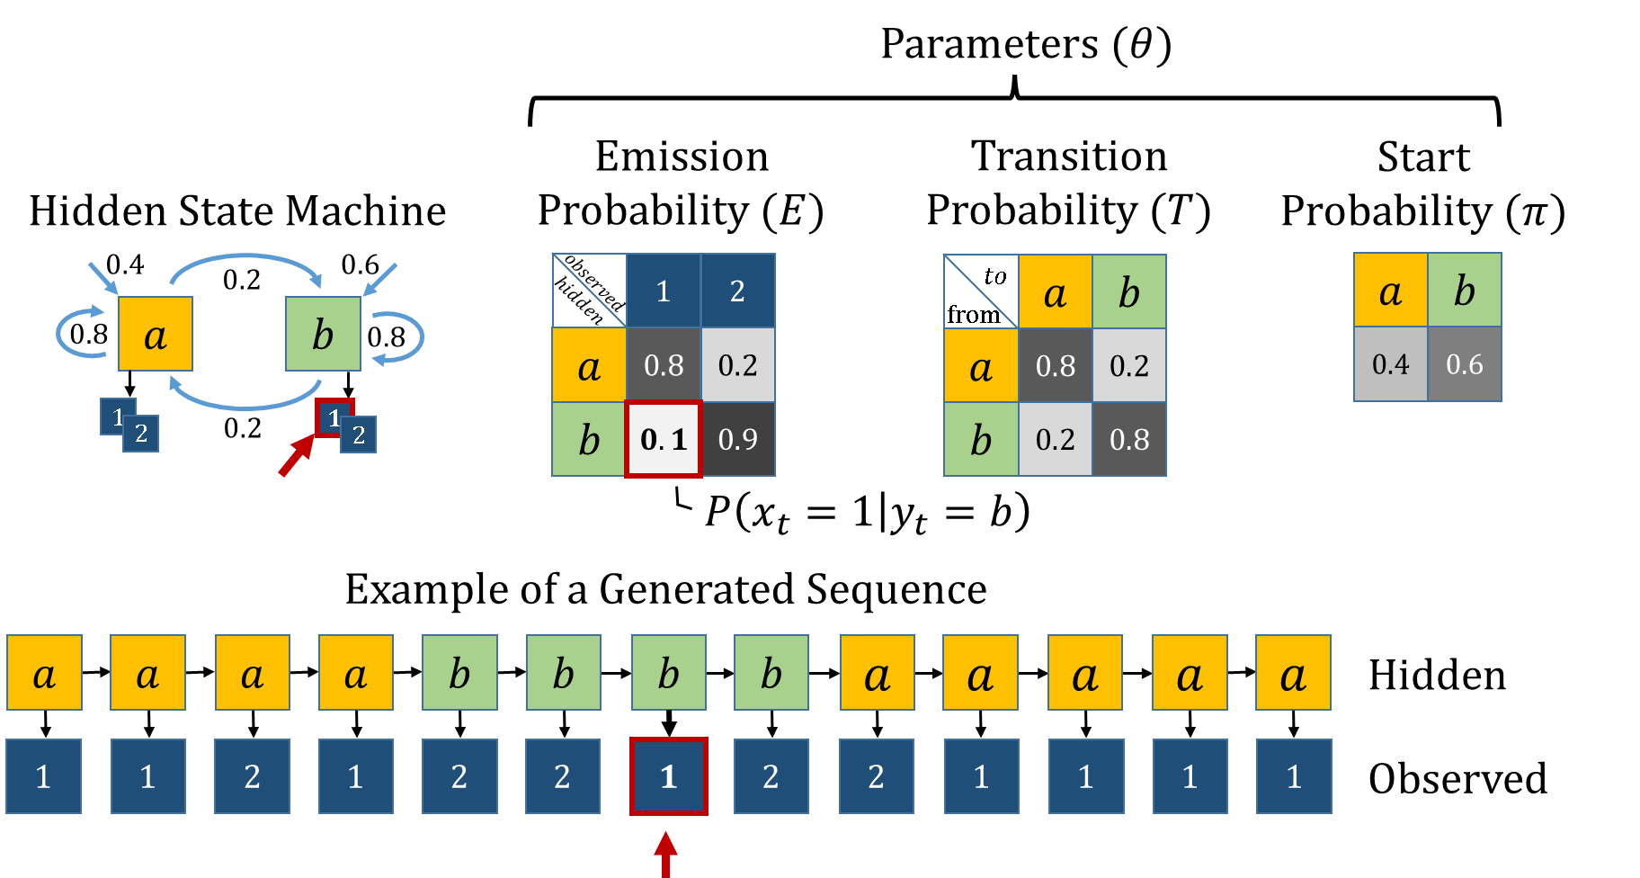
Hidden Markov Model

Slide 33
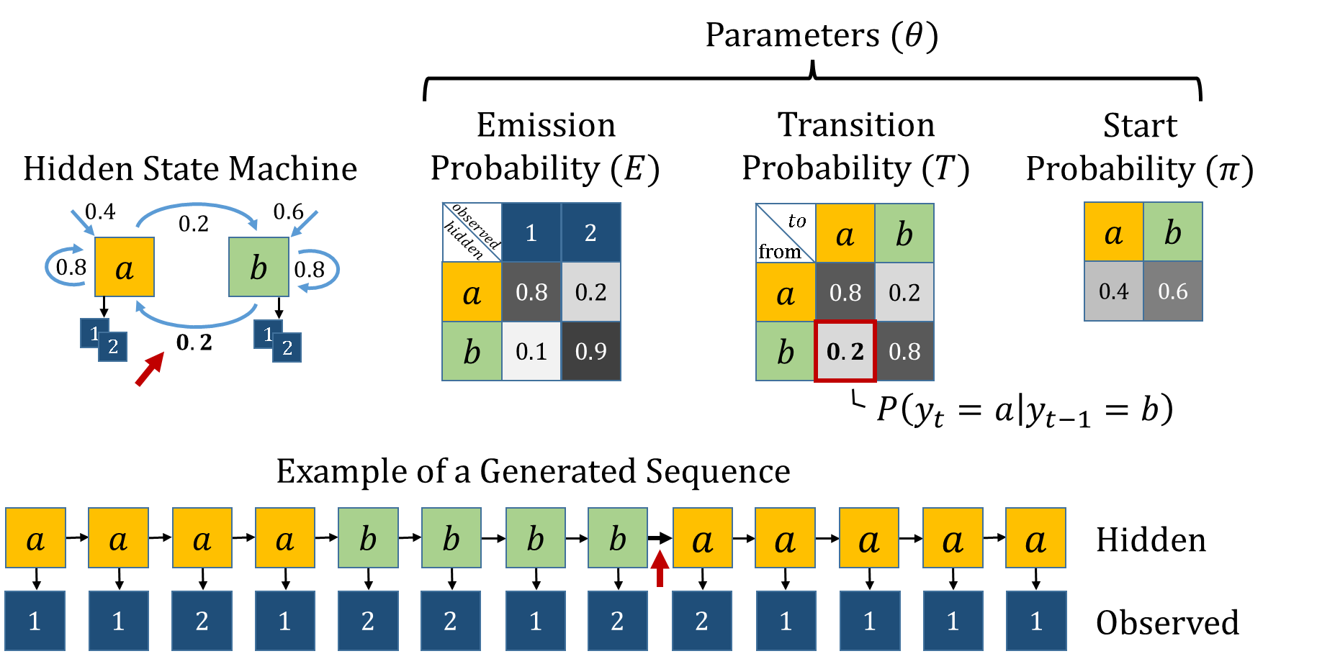
Hidden Markov Model

Slide 34
Outlines
Research Goal
Gene Regulation
TFBS & PWMs
HMM
HOP-HMM
Baum-Welch
Evaluation
Human DNA

Slide 35
HMM to HOP-HMM
HOP-HMM
$$0.5$$
$$0.05$$
$$0.0$$
$$0.05$$
$$0.1$$
$$0.8$$
$$BG_{1}$$
$$TF_{1}^{1}$$
$$TF_{2}^{1}$$
$$TF_{3}^{1}$$
HMM
$$1$$
$$G$$
$$T$$
$$A$$
$$C$$
$$BG_{1}$$
$$BG_{2}$$
$$0.5$$
$$G$$
$$T$$
$$0.8$$
$$BG_{2}$$
$$TF_{1}^{2}$$
$$TF_{2}^{2}$$
$$TF_{3}^{2}$$
$$G$$
$$T$$
$$A$$
$$C$$
$$A$$
$$C$$
$$0.1$$
$$1$$
$$G$$
$$T$$
$$A$$
$$C$$

Slide 36
Enhancer
DNA
TF
TF

Slide 37
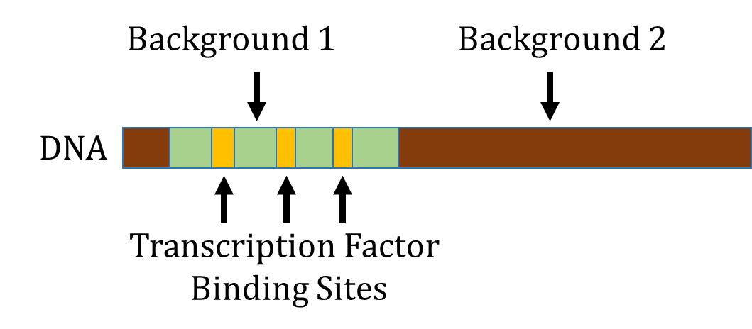

Slide 38
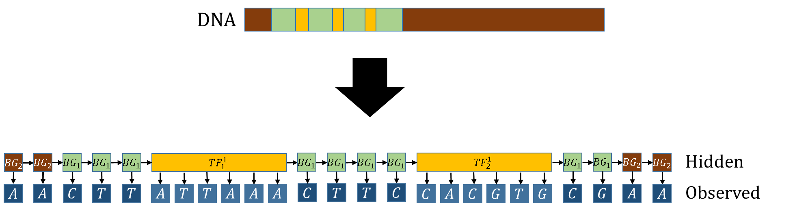
HOP-HMM matches the structure of the enhancer

Slide 39


Slide 40
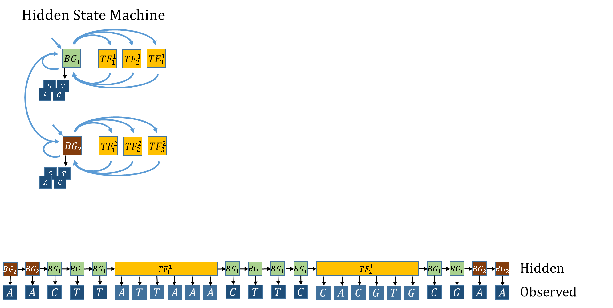

Slide 41
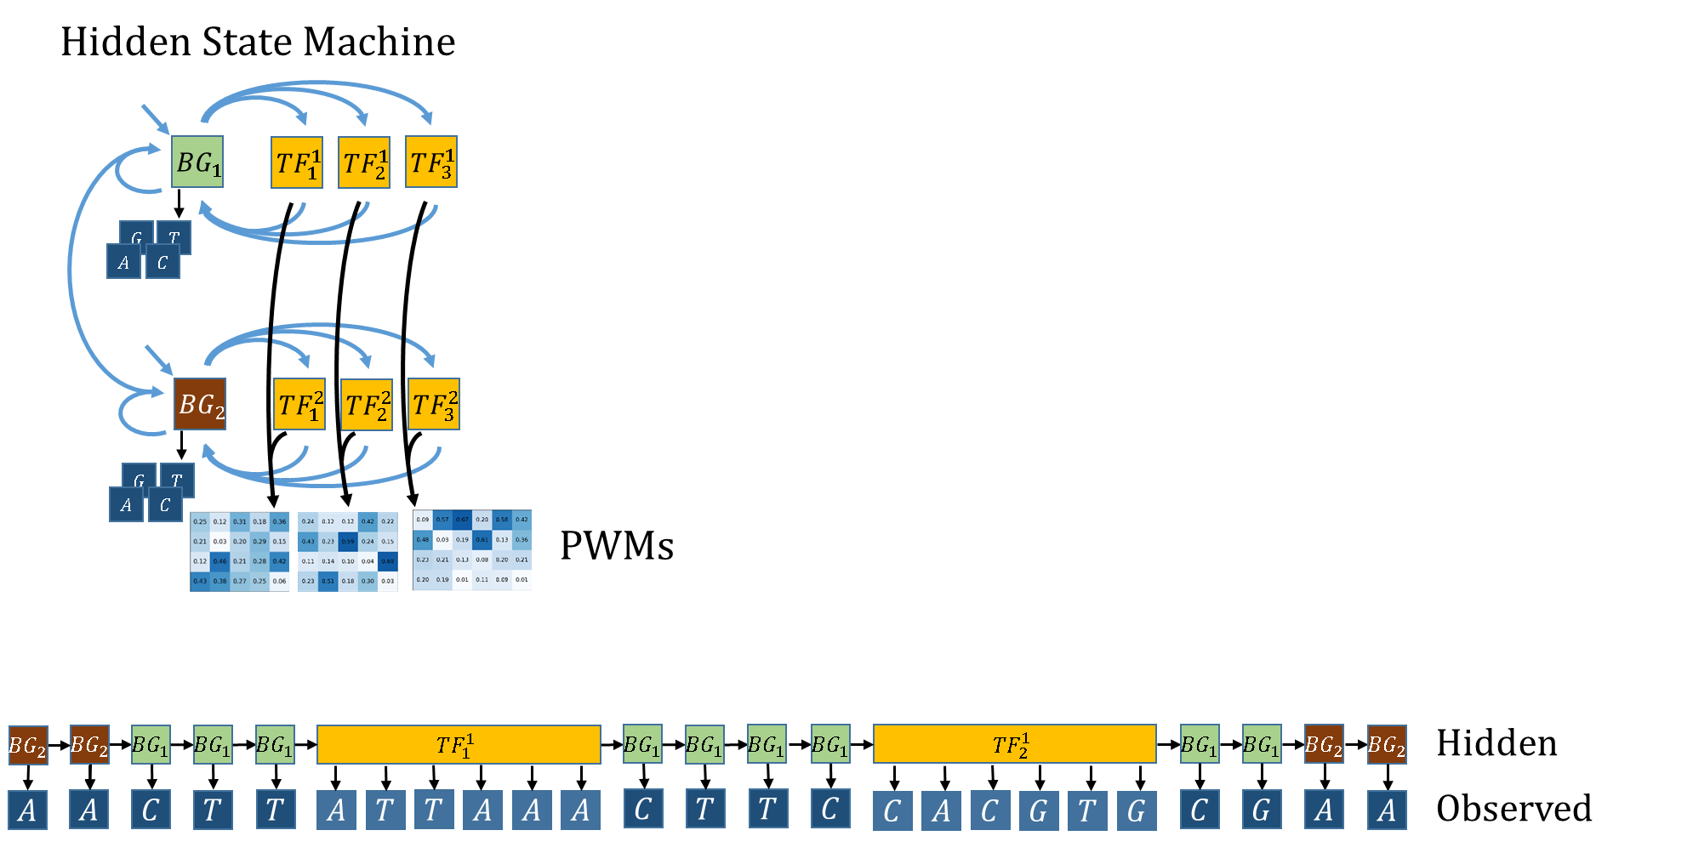

Slide 42
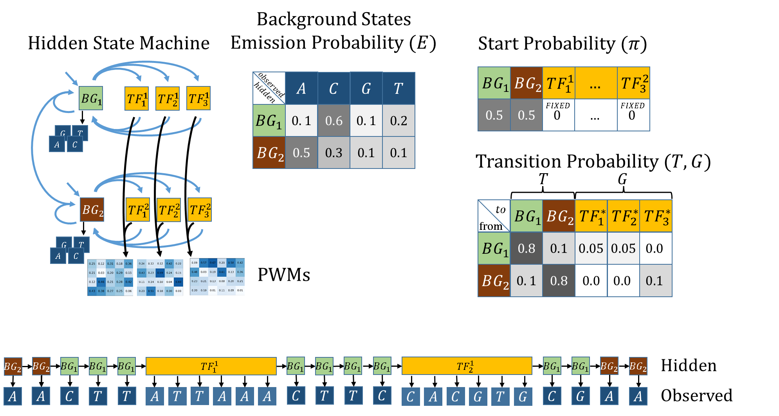

Slide 43


Slide 44
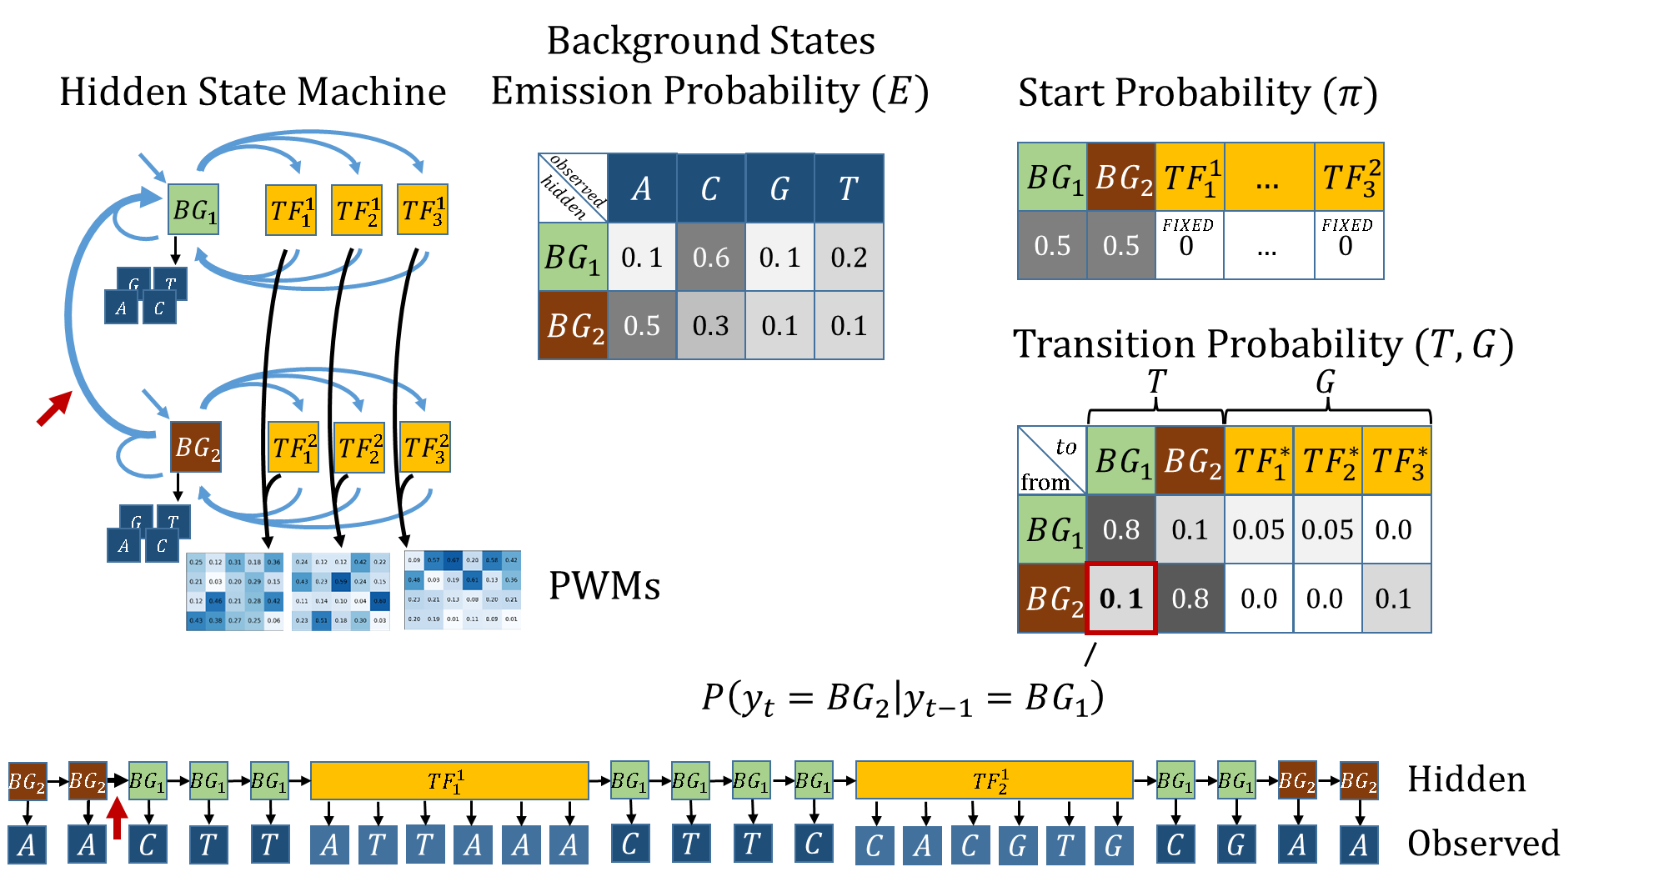

Slide 45
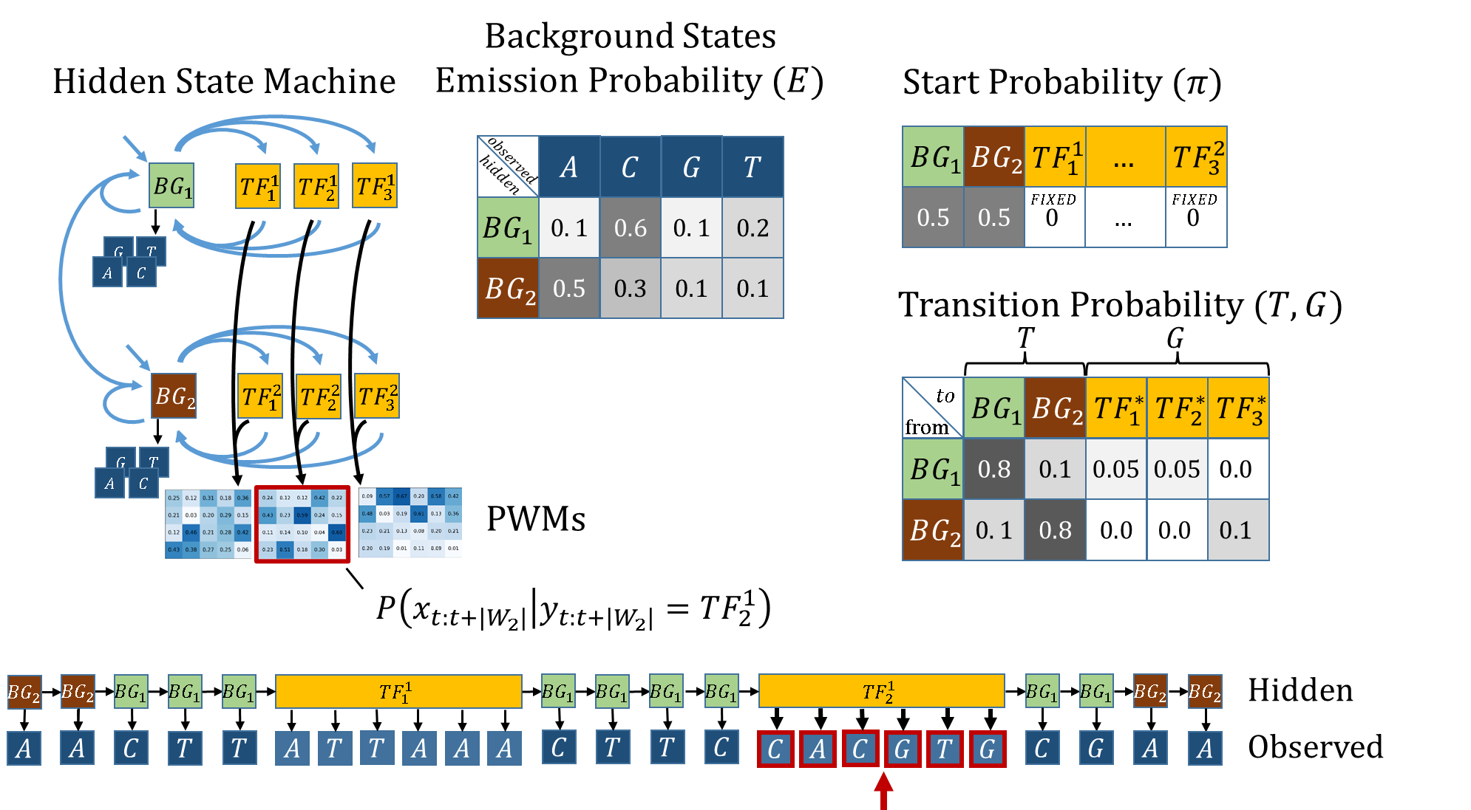

Slide 46


Slide 47
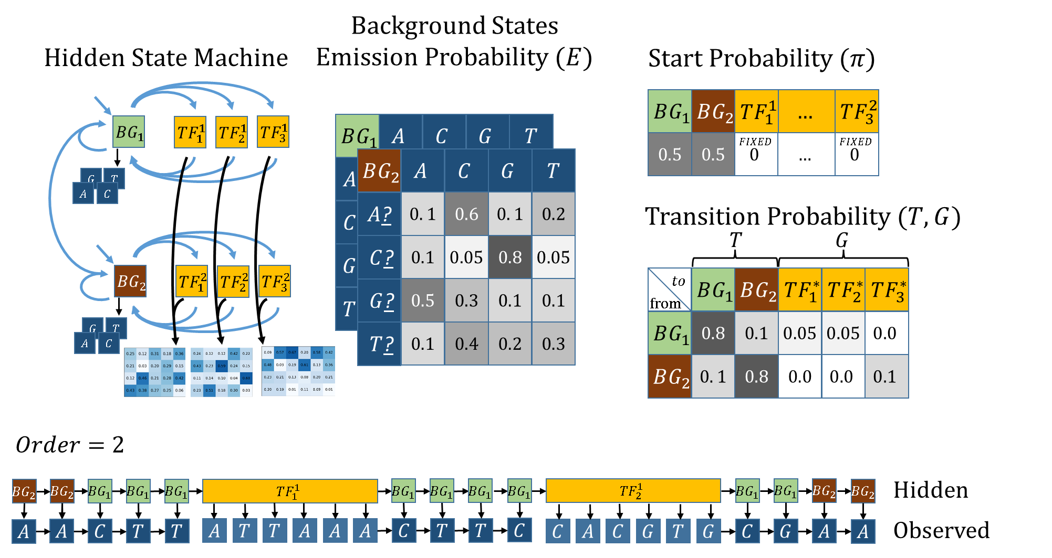

Slide 48
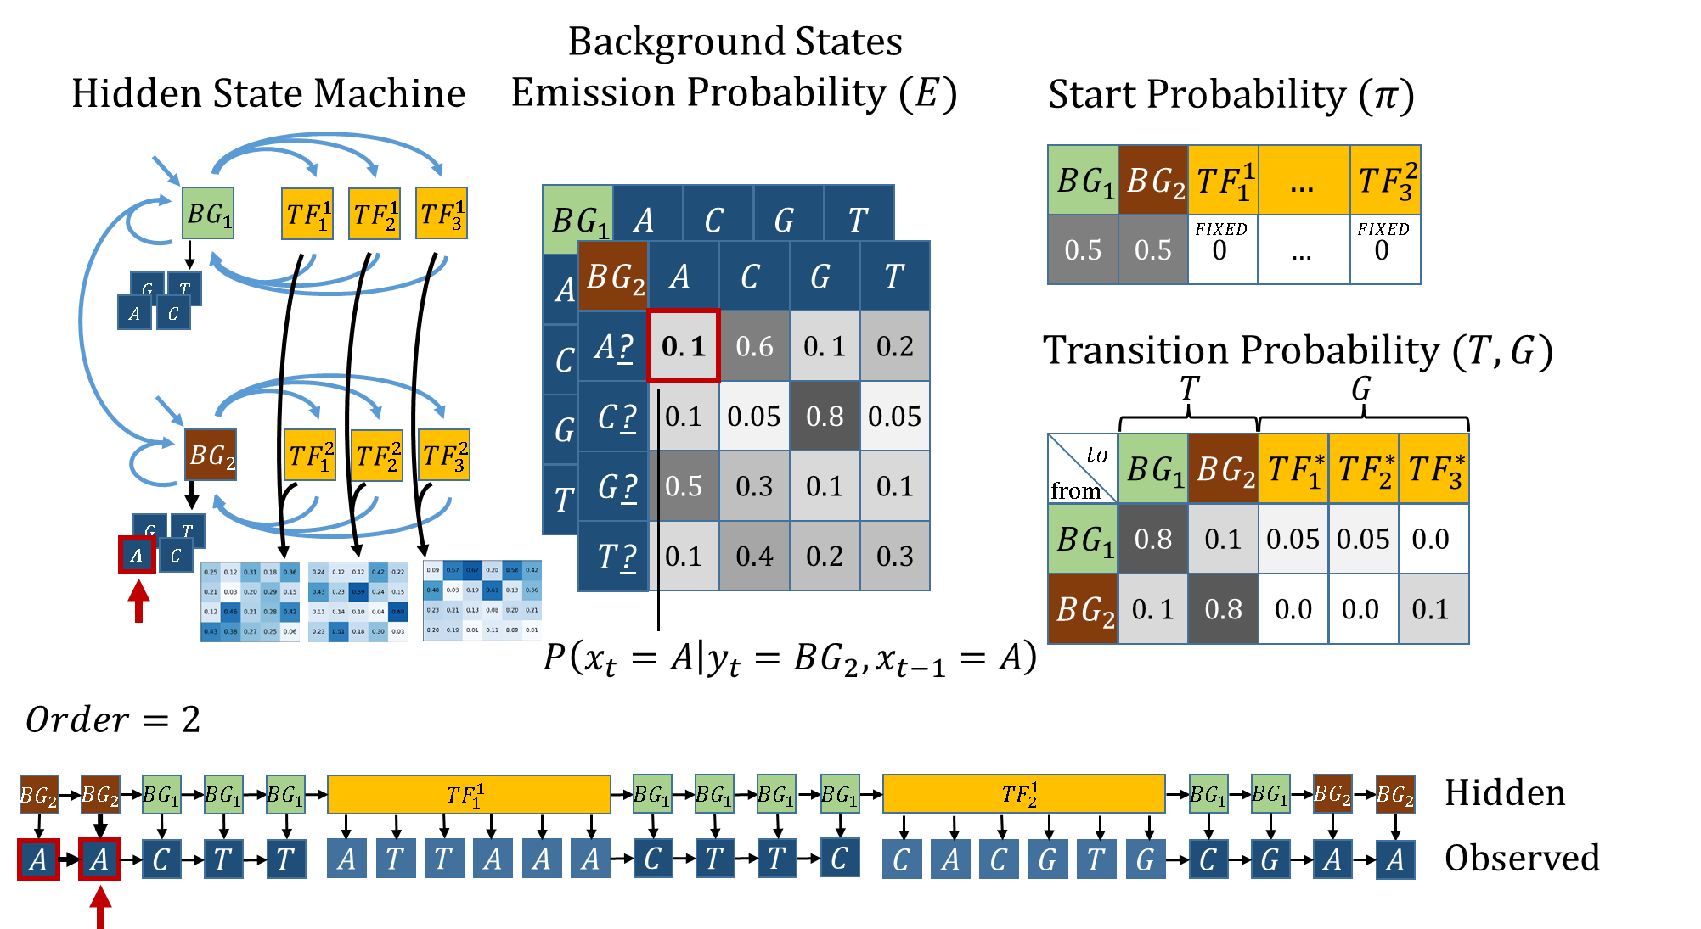

Slide 49
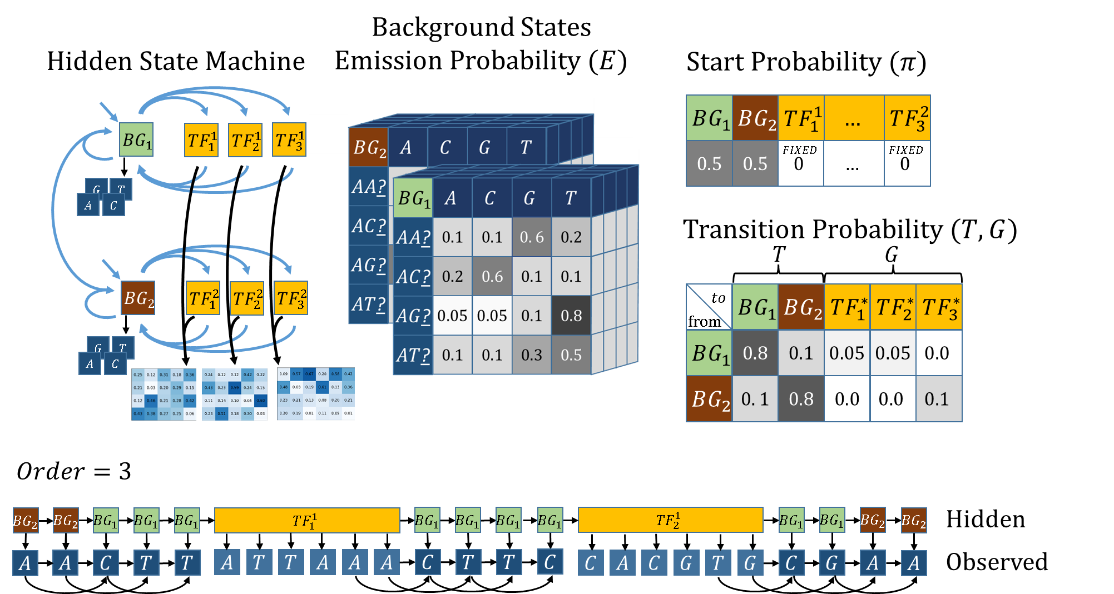

Slide 50
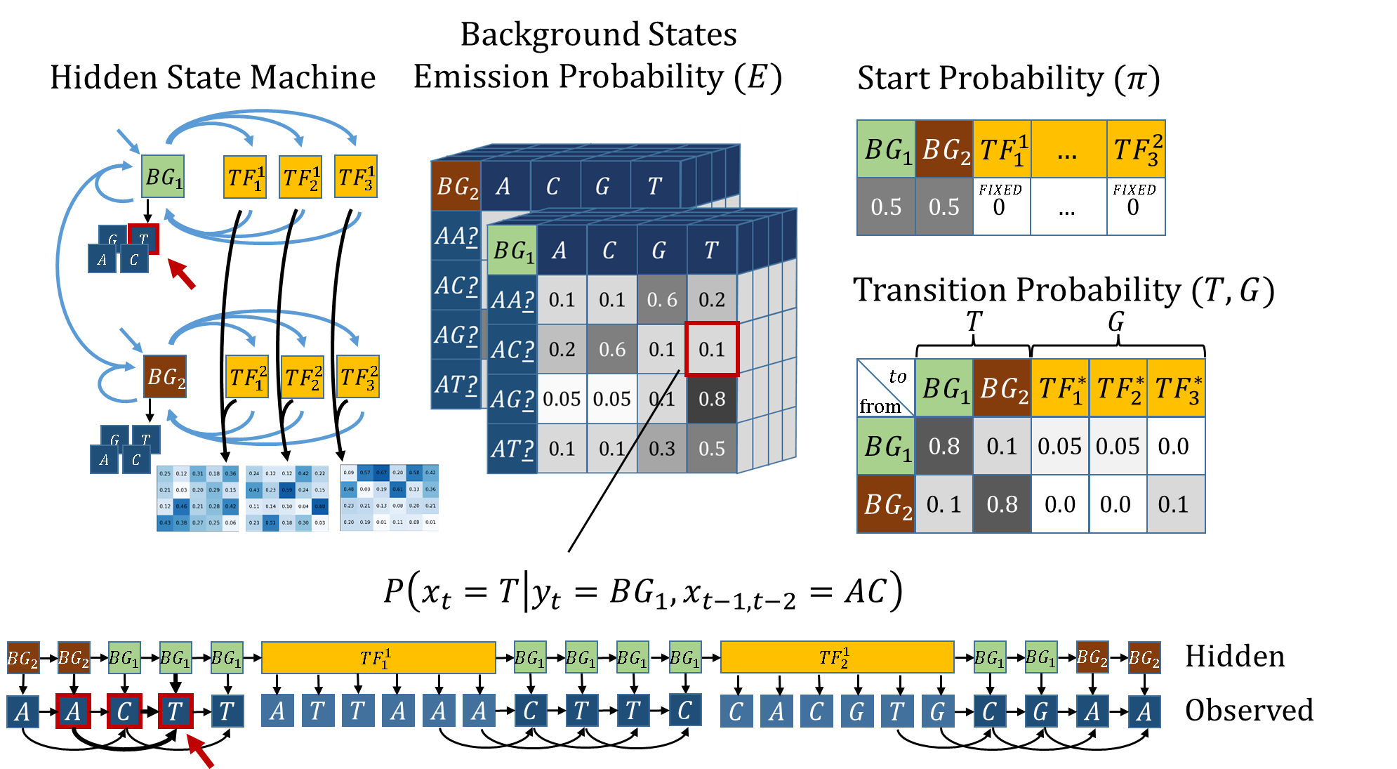

Slide 51
Outlines
Research Goal
Gene Regulation
TFBS & PWMs
HMM
HOP-HMM
Baum-Welch
Evaluation
Human DNA

Slide 52
Posterior Probability

Slide 53
Posterior Probability
What is it?
Calculation
HOP-HMM Adaptations

Slide 54

Posterior Probability- What is it?

Slide 55
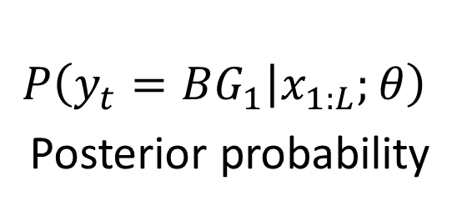
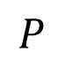
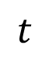
Posterior Probability- What is it?
$$P$$
$$P\left(y_{t}=BG_{1} | x_{1:L};θ\right)$$
Posterior probability
$$t$$

Slide 56
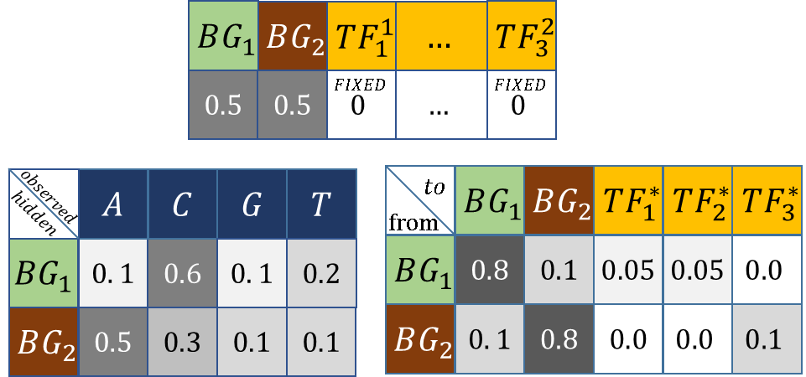
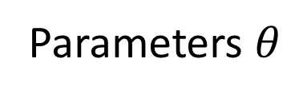
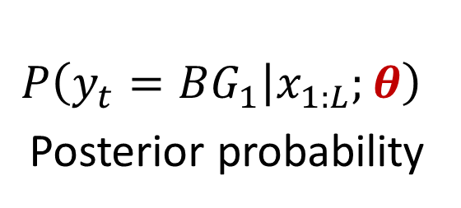
Posterior Probability- What is it?
Given:
$$P$$
Parameters $θ$
$$P\left(y_{t}=BG_{1} | x_{1:L};θ\right)$$
Posterior probability
$$t$$

Slide 57
Posterior Probability
$$P\left(y_{t}=BG_{1} | x_{1:L};θ\right)$$
Posterior probability

Slide 58

Posterior Probability - Calculation
$$P\left(y_{t} | x_{1:L}\right)$$

Slide 59

Posterior Probability - Calculation
$$P\left(y_{t} | x_{1:L}\right)=\frac{P\left(y_{t},x_{1:t}\right)⋅P\left({x_{t+1:L}|y}_{t},x_{1:t}\right) }{P\left(x_{1:t}\right) }$$

Slide 60



Posterior Probability - Calculation
$$P\left(y_{t} | x_{1:L}\right)=\frac{P\left(y_{t},x_{1:t}\right)⋅P\left({x_{t+1:L}|y}_{t},x_{1:t}\right) }{P\left(x_{1:t}\right) }$$
$α_{j,t}: P\left(y_{t}=j,x_{1:t}\right)$ Forward Probability

Slide 61

Posterior Probability - Calculation
$$P\left(y_{t} | x_{1:L}\right)=\frac{P\left(y_{t},x_{1:t}\right)⋅P\left({x_{t+1:L}|y}_{t},x_{1:t}\right) }{P\left(x_{1:t}\right) }$$
$α_{j,t}: P\left(y_{t}=j,x_{1:t}\right)$ Forward Probability
$$α_{j,t}=E_{{\text{j}\text{,}\text{x}}_{t}}⋅\sum_{\text{j}\text{′}∈\text{[}\text{m}\text{]}}{T_{\text{j}\text{′}\text{,}\text{j}}⋅α_{\text{j}\text{′}\text{,}\text{t}\text{−}\text{1}}}$$

Slide 62



Posterior Probability - Calculation
$$P\left(y_{t} | x_{1:L}\right)=\frac{P\left(y_{t},x_{1:t}\right)⋅P\left({x_{t+1:L}|y}_{t},x_{1:t}\right) }{P\left(x_{1:t}\right) }$$
$$β_{j,t}:P\left({x_{t+1:L}|y}_{t}\right)$$
Backward Probability

Slide 63

Posterior Probability - Calculation
$$P\left(y_{t} | x_{1:L}\right)=\frac{P\left(y_{t},x_{1:t}\right)⋅P\left({x_{t+1:L}|y}_{t},x_{1:t}\right) }{P\left(x_{1:t}\right) }$$
$$β_{j,t}:P\left({x_{t+1:L}|y}_{t}\right)$$
Backward Probability
$$β_{j,t}=\sum_{\text{j}\text{′}∈\text{[}\text{m}\text{]}}{β_{\text{j}\text{′}\text{,}\text{t}\text{+}\text{1}}⋅E_{{\text{j}\text{′}\text{,}\text{x}}_{t+1}}⋅T_{\text{j}\text{,}\text{j}\text{′}}}$$

Slide 64








Posterior Probability
$$BG_{1}$$
$$BG_{1}$$
$$BG_{1}$$
$$BG_{1}$$
$$BG_{1}$$
$$BG_{1}$$
$$C$$
$$T$$
$$A$$
$$C$$
$$T$$
$$T$$
$$P\left(y_{t} | x_{1:L}\right)=\frac{P\left(y_{t},x_{1:t}\right)⋅P\left({x_{t+1:L}|y}_{t},x_{1:t}\right) }{P\left(x_{1:t}\right) }$$
$$β_{j,t}:P\left({x_{t+1:L}|y}_{t}\right)$$
Backward Probability
$$β_{j,t}=\sum_{\text{j}\text{′}∈\text{[}\text{m}\text{]}}{β_{\text{j}\text{′}\text{,}\text{t}\text{+}\text{1}}⋅E_{{\text{j}\text{′}\text{,}\text{x}}_{t+1}}⋅T_{\text{j}\text{,}\text{j}\text{′}}}$$

Slide 65

Posterior Probability (HOP-HMM)
$$BG_{1}$$
$$BG_{1}$$
$$BG_{1}$$
$$BG_{1}$$
$$BG_{1}$$
$$BG_{1}$$
$$C$$
$$T$$
$$A$$
$$C$$
$$T$$
$$T$$
$$P\left(y_{t} | x_{1:L}\right)=\frac{P\left(y_{t},x_{1:t}\right)⋅P\left({x_{t+1:L}|y}_{t},x_{1:t}\right) }{P\left(x_{1:t}\right) }$$
$$β_{j,t}:P\left({x_{t+1:L}|y}_{t},x_{1:t}\right)$$
Backward Probability
$$β_{j,t}=\sum_{\text{j}\text{′}∈\text{[}\text{m}\text{]}}{β_{\text{j}\text{′}\text{,}\text{t}\text{+}\text{1}}⋅E_{{\text{j}\text{′}\text{,}\text{x}}_{t+1}}⋅T_{\text{j}\text{,}\text{j}\text{′}}}$$

Slide 66


















Forward Algorithm
$$t\text{−}|W_{1}|\text{−}1$$
$$t\text{−}|W_{2}|\text{−}1$$
$$t$$
$$t\text{−}1$$
$$t$$
$$α_{j,t}$$
$$j$$
$$α_{j,t}$$
$$j$$
Backward Algorithm
$$t$$
$$t\text{−}|W_{2}|\text{−}1$$
$$t\text{−}|W_{1}|\text{−}1$$
$$t$$
$$t\text{+}1$$
$$β_{j,t}$$
$$j$$
$$β_{j,t}$$
$$j$$

Slide 67

































EM (Baum-Welch)
$$x_{1:L}$$
$$C$$
$$A$$
$$C$$
$$G$$
$$T$$
$$G$$
$$T$$
$$T$$
$$A$$
$$G$$
$$A$$
$$T$$
$$T$$
$$A$$
$$A$$
$$G$$
$$C$$
$$A$$
$$C$$
$$G$$
$$T$$
$$G$$
$$T$$
$$A$$
$$A$$
$$G$$
$$C$$
$$A$$
$$C$$
$$G$$
$$T$$
$$G$$
E-step
M-step
$$P$$
$$P\left(y_{t}=BG_{1} | x_{1:L};θ\right)$$
Posterior probability
$$t$$
Parameters $θ$

Slide 68
EM (Baum-Welch)
$$x_{1:L}$$
$$C$$
$$A$$
$$C$$
$$G$$
$$T$$
$$G$$
$$T$$
$$T$$
$$A$$
$$G$$
$$A$$
$$T$$
$$T$$
$$A$$
$$A$$
$$G$$
$$C$$
$$A$$
$$C$$
$$G$$
$$T$$
$$G$$
$$T$$
$$A$$
$$A$$
$$G$$
$$C$$
$$A$$
$$C$$
$$G$$
$$T$$
$$G$$
E-step
M-step
$$P$$
$$P\left(y_{t}=BG_{1} | x_{1:L};θ\right)$$
Posterior probability
$$t$$
Parameters $θ$

Slide 69
Outlines
Research Goal
Gene Regulation
TFBS & PWMs
HMM
HOP-HMM
Baum-Welch
Evaluation
Human DNA

Slide 70


Slide 71

EM Regularization

Slide 72


Slide 73


Slide 74
Outlines
Research Goal
Gene Regulation
TFBS & PWMs
HMM
HOP-HMM
Baum-Welch
Evaluation
Human DNA

Slide 75


Slide 76

Umbilical Vein Endothelial (E122) vs Monocyte (E124)
H3K27ac
Umbilical Vein
Endothelial
DNase-I
ChromHMM
HOP-HMM
Prediction
Posterior
Probability
Viterbi Path
H3K27ac
Monocyte
DNase-I
ChromHMM
hg19:chr1

Slide 77
Umbilical Vein Endothelial (E122) vs Monocyte (E124)
H3K27ac
Umbilical Vein
Endothelial
DNase-I
ChromHMM
HOP-HMM
Prediction
Posterior
Probability
FOXQ1
FOXD3
FOXD3
Viterbi Path
FOXP1
DIX1
FOXP1
H3K27ac
Monocyte
DNase-I
ChromHMM
hg19:chr1

Slide 78


Gastric (E094) vs Mesendoderm (E004)
H3K27ac
Gastric
DNase-I
ChromHMM
HOP-HMM
Prediction
Posterior
Probability
GSC2
HLTF
HLTF
SRY
Viterbi Path
H3K27ac
Mesendoderm
DNase-I
ChromHMM
hg19:chr5

Slide 79
Mesendoderm (E004) vs Ovary (E097)
H3K27ac
Mesendoderm
DNase-I
ChromHMM
HOP-HMM
Prediction
Posterior
Probability
POU5F1B
NFATC2
Viterbi Path
H3K27ac
Ovary
DNase-I
ChromHMM
hg19:chr11

